Slide 1
Relativity 105: Acceleration In Special Relativity
Hyperbolic Motion (acceleration), Rindler Horizon
Rindler Coordinates and Bell’s Spaceship Paradox
Basis Vectors/Jacobian in Curvilinear Coordinates
The Proper Time Along Curves and Twin Paradox
Covariant Derivative
Geodesic Curves (inertial frames/zero forces)
Notes:
In this video we’re going to talk about relativistic dynamics, which is how things like forces, energy, and momentum work in special relativity. We’ll also derive the famous equations E = mc^2.

Slide 2
How to solve Rindler Geodesics
https://npac.lal.in2p3.fr/wp-content/uploads/2019/Cours-S1/Relativite/TD1.pdf
https://www.sryahwapublications.com/open-access-journal-of-physics/pdf/v2-i4/4.pdf
Time dilation integral notes: https://physics.stackexchange.com/questions/242043/what-is-the-proper-way-to-explain-the-twin-paradox/244323#244323

Slide 3
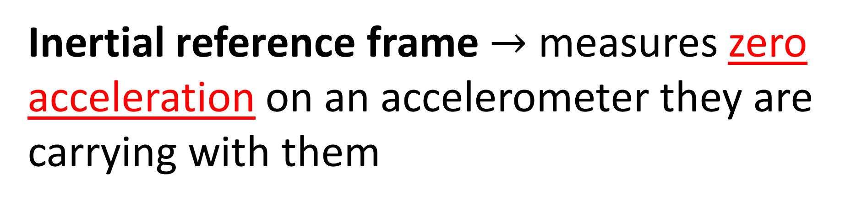
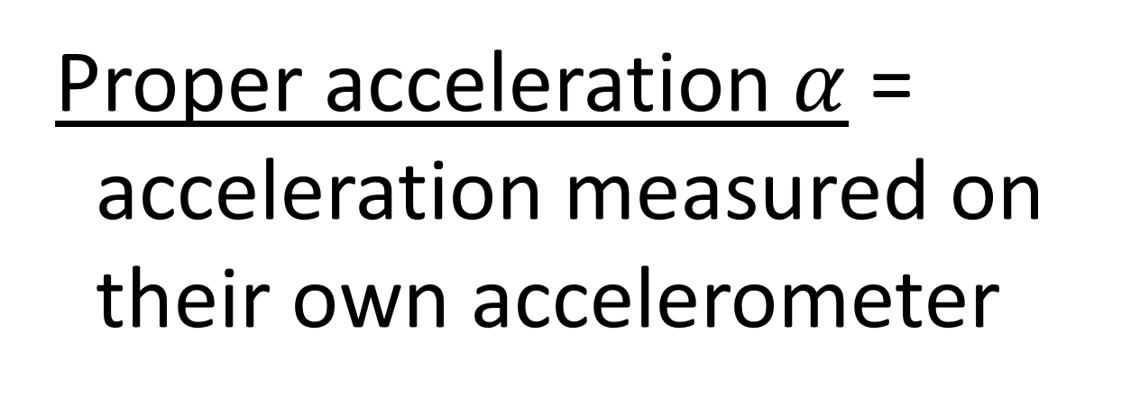
Inertial reference frame $→$ measures zero acceleration on an accelerometer they are carrying with them
Proper acceleration $α$ =
acceleration measured on
their own accelerometer
accelerometer

Slide 4
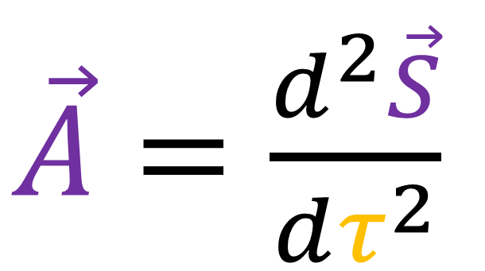
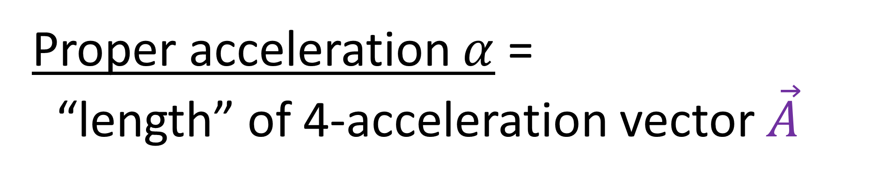
From Relativity 105a…
Proper acceleration $α$ =
“length” of 4-acceleration vector $\vec{A}$
4-position
$\vec{A}=\frac{d^{2}\vec{S}}{dτ^{2}}$
proper time

Slide 5
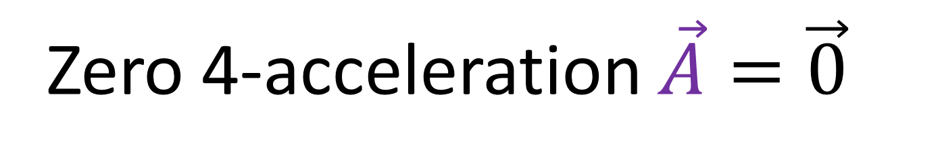
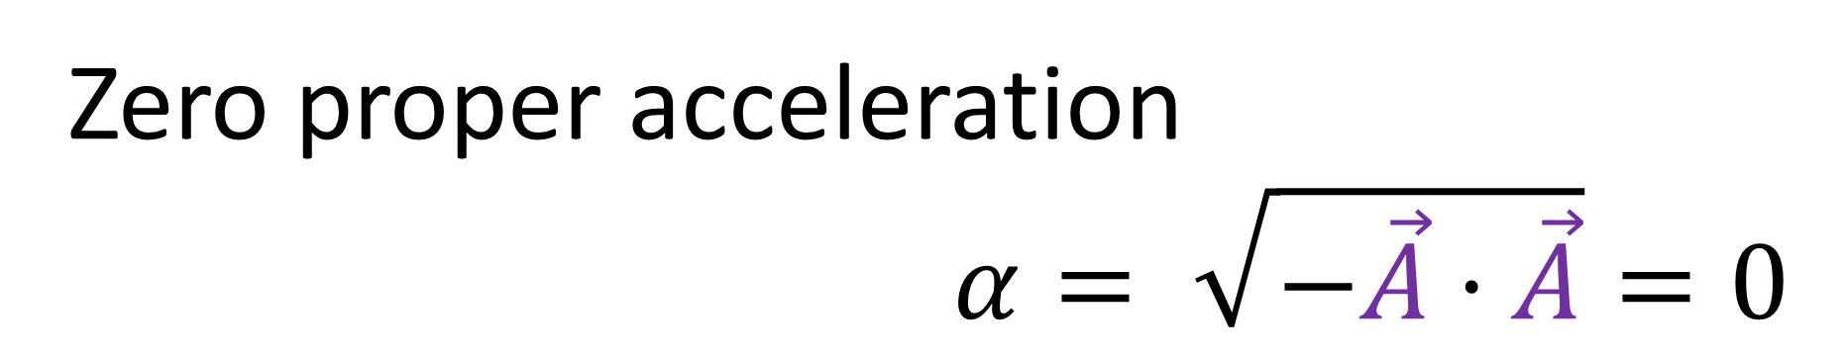
Inertial Observer Definition
Zero proper acceleration
$α= \sqrt{−\vec{A}⋅\vec{A}}=0$
— OR —
Zero 4-acceleration $\vec{A}=\vec{0}$

Slide 6
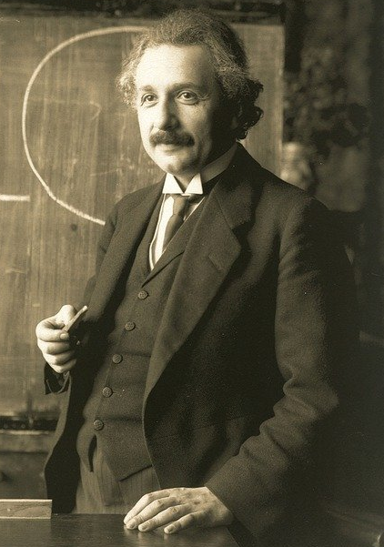
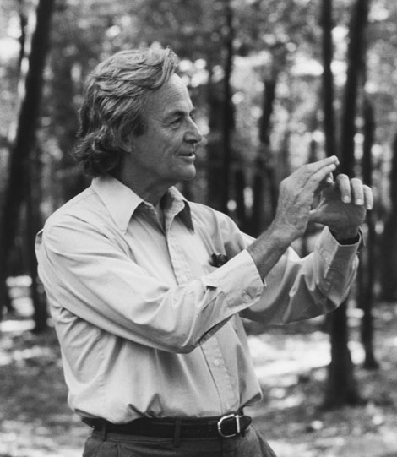



Normally, we think...
$$ct$$
inertial observer = straight worldline?
$$x$$
light beam = straight worldline?

Slide 7
“Inertial observers and beams of light will always travel in straight lines on spacetime diagrams.”
“Inertial observers and beams of light can have curved worldlines on spacetime diagrams.”

Slide 8
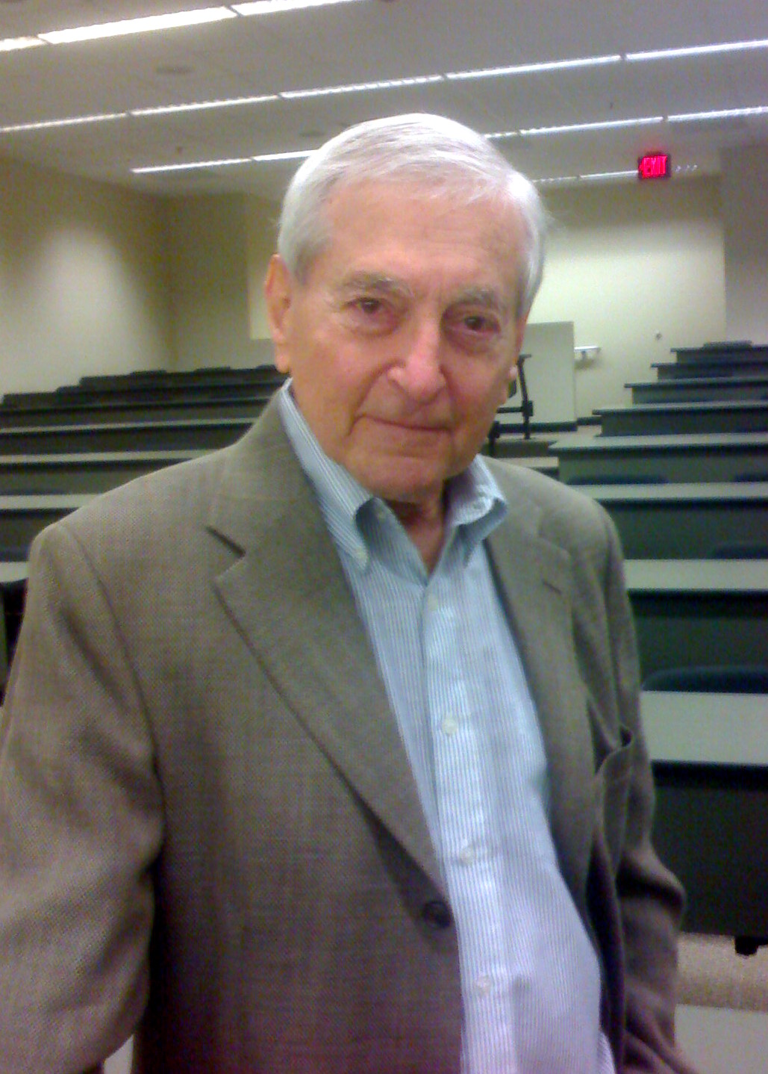
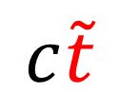
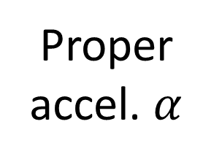
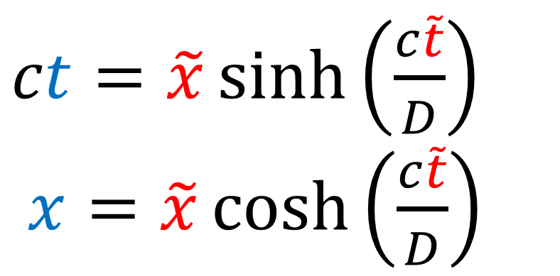
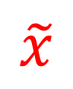
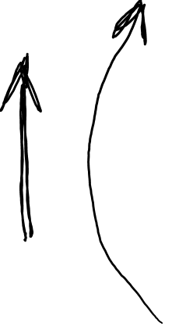
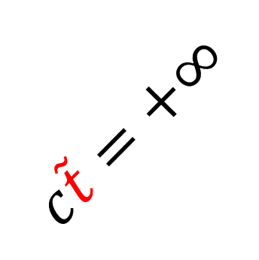
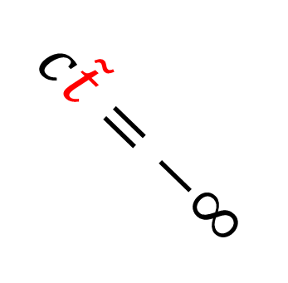


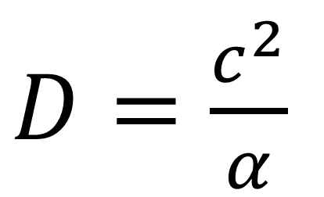
Proper accel. $α$
Rindler Coordinates
$$ct$$
$$c\tilde{t}=+∞$$
$ct=\tilde{x}\sinh\left(\frac{c\tilde{t}}{D}\right)$
$x=\tilde{x}\cosh\left(\frac{c\tilde{t}}{D}\right)$
$$c\tilde{t}$$
$$\tilde{x}$$
$$x$$
$D=\frac{c^{2}}{α}$
$$c\tilde{t}=−∞$$

Slide 9
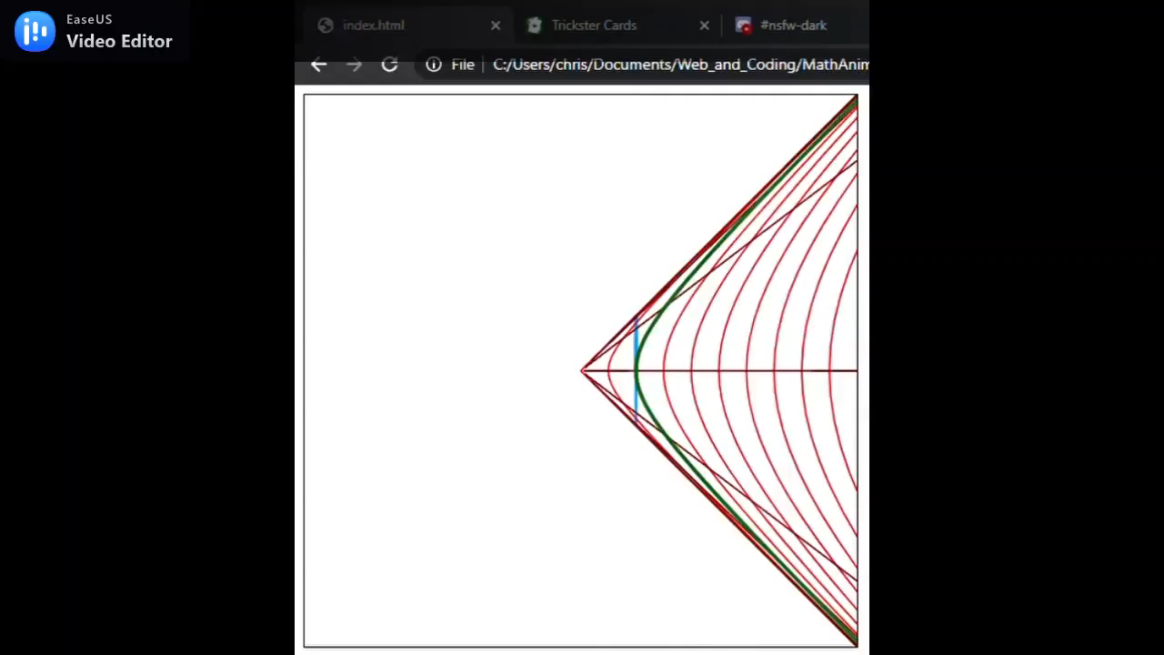
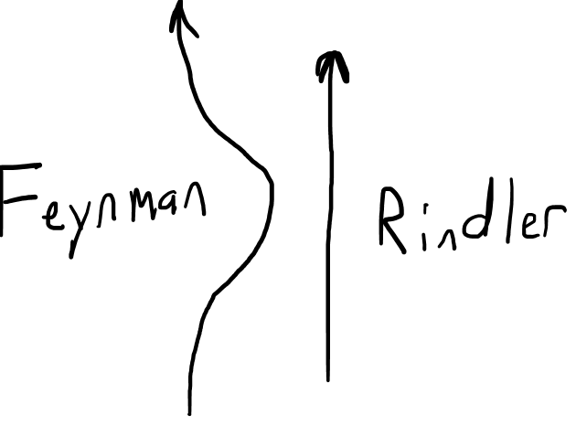

Slide 10
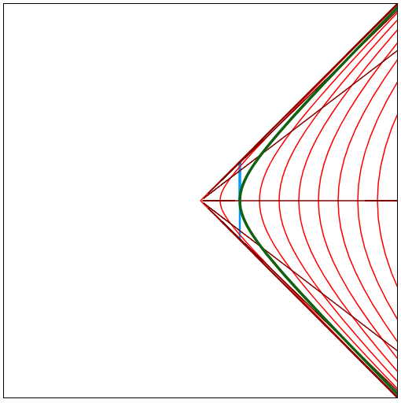
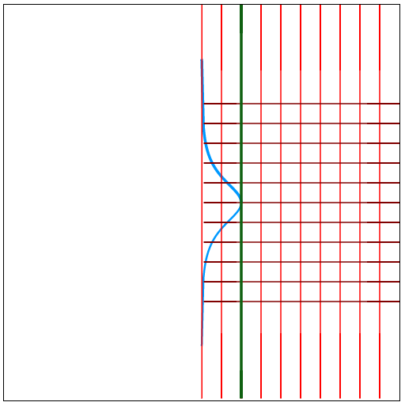
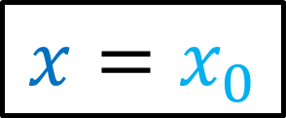
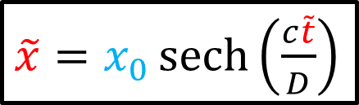
Inertial Observer’s perspective
Non-Inertial Observer’s perspective
$$x=x_{0}$$
$\tilde{x}=x_{0}\operatorname{sech}\left(\frac{c\tilde{t}}{D}\right)$

Slide 11
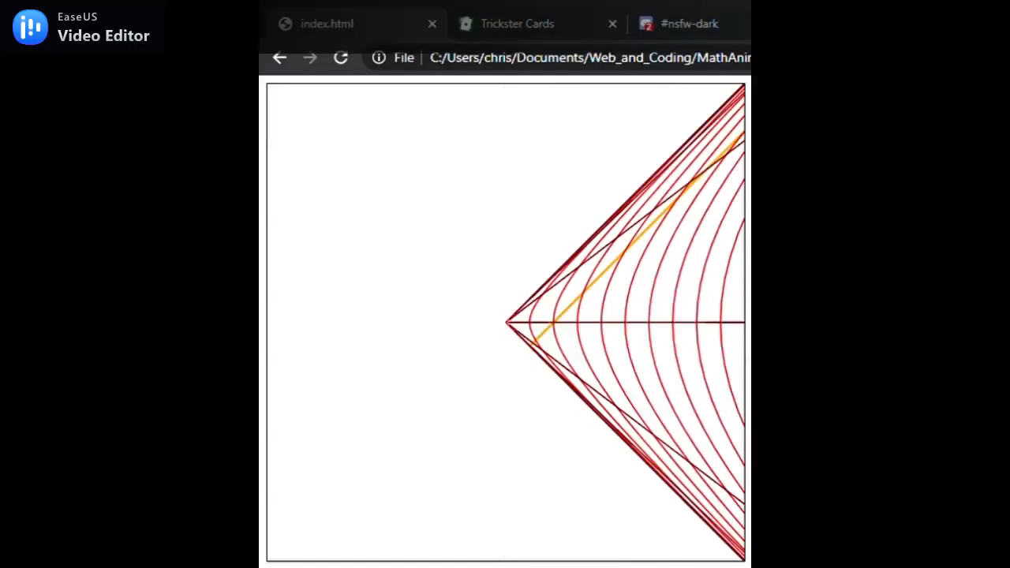


Slide 12
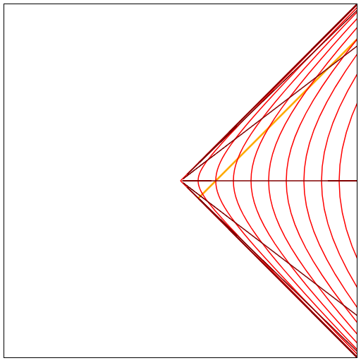
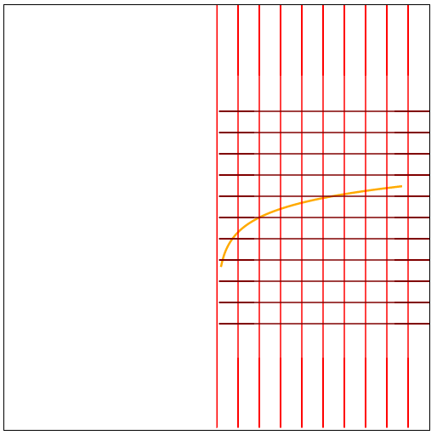
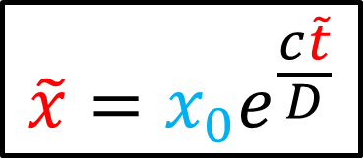
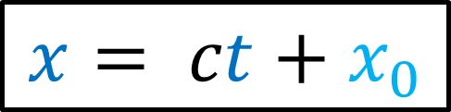
Inertial Observer’s perspective
Non-Inertial Observer’s perspective
$$x= ct+x_{0}$$
$$\tilde{x}=x_{0}e^{\frac{c\tilde{t}}{D}}$$

Slide 13
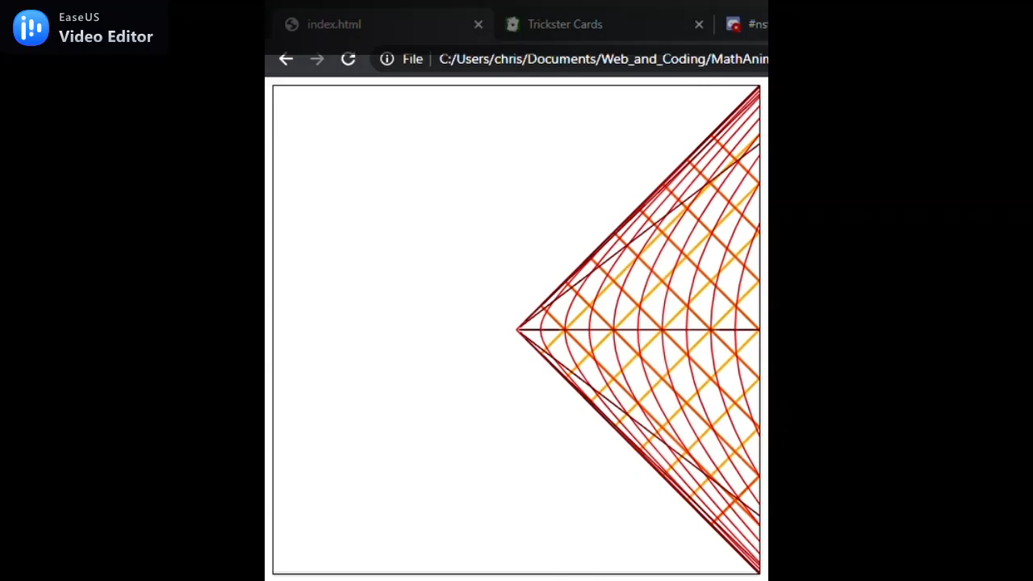
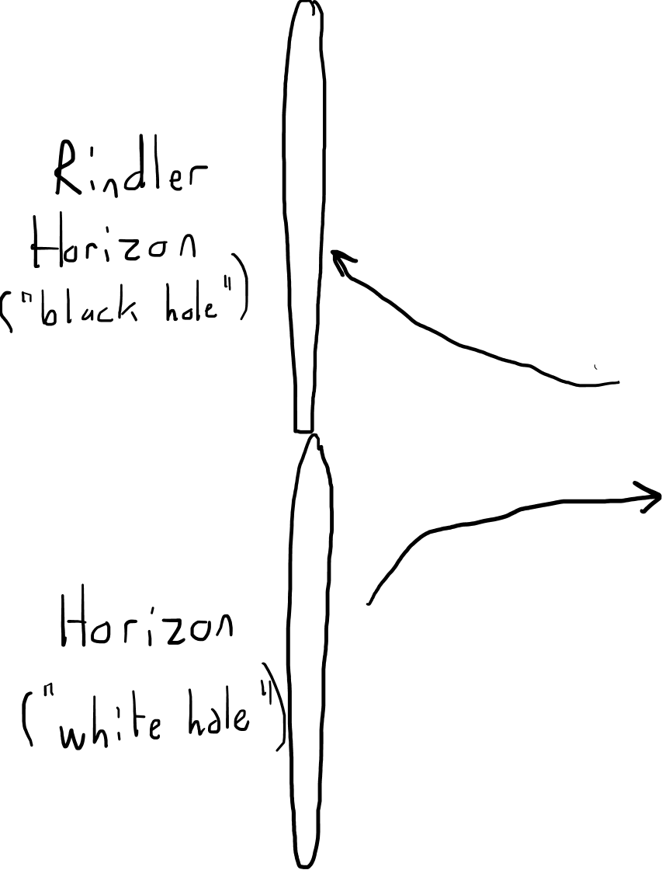

Slide 14
From the point of view of an INERTIAL REFERENCE FRAME (zero proper acceleration)…
other inertial observers and beams of light will always have straight worldlines
From the point of view of a NON-INERTIAL REFERENCE FRAME…
inertial observers and beams of light can have curved worldlines

Slide 15
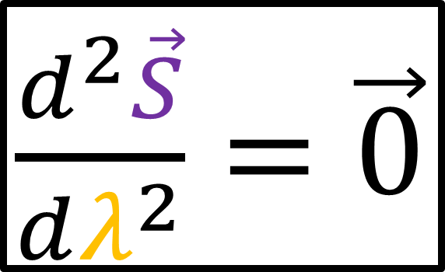

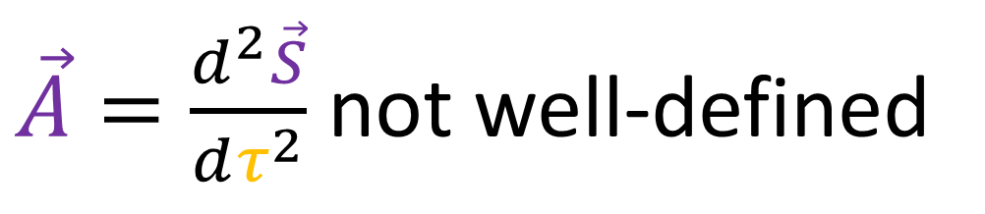
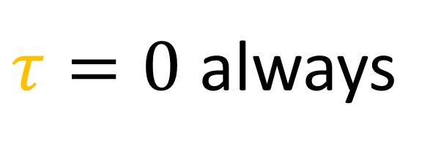

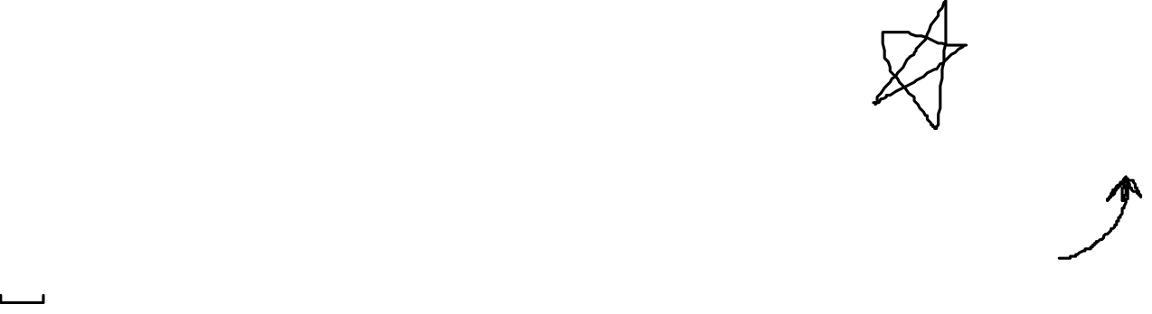
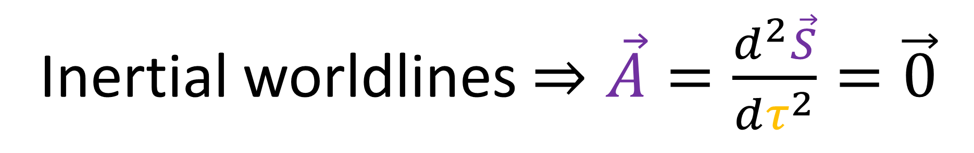
Inertial worldlines $≠$ straight lines
Inertial worldlines $⇒\vec{A}=\frac{d^{2}\vec{S}}{dτ^{2}}=\vec{0}$
(definition works in all coordinate systems)
$\frac{d^{2}\vec{S}}{dλ^{2}}=\vec{0}$
Light-like worldlines $⇒$ ?
$τ=0$ always
$\vec{A}=\frac{d^{2}\vec{S}}{dτ^{2}}$ not well-defined
path parameter

Slide 16
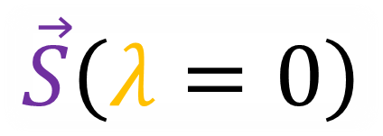
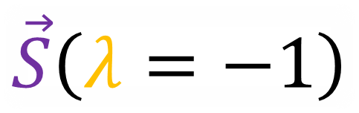

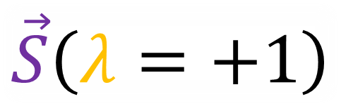
Path parameter $λ$ has no physical meaning.
$$ct$$
$$\vec{S}\left(λ=+1\right)$$
$$x$$
$$\vec{S}\left(λ=−1\right)$$
$$\vec{S}\left(λ=0\right)$$

Slide 17

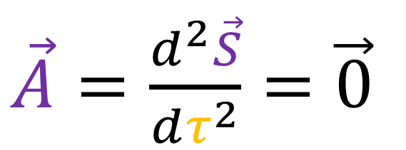
$\frac{d^{2}\vec{S}}{dλ^{2}}=\vec{0}$
Inertial
worldlines
Light-like
worldlines
$\vec{A}=\frac{d^{2}\vec{S}}{dτ^{2}}=\vec{0}$

Slide 18
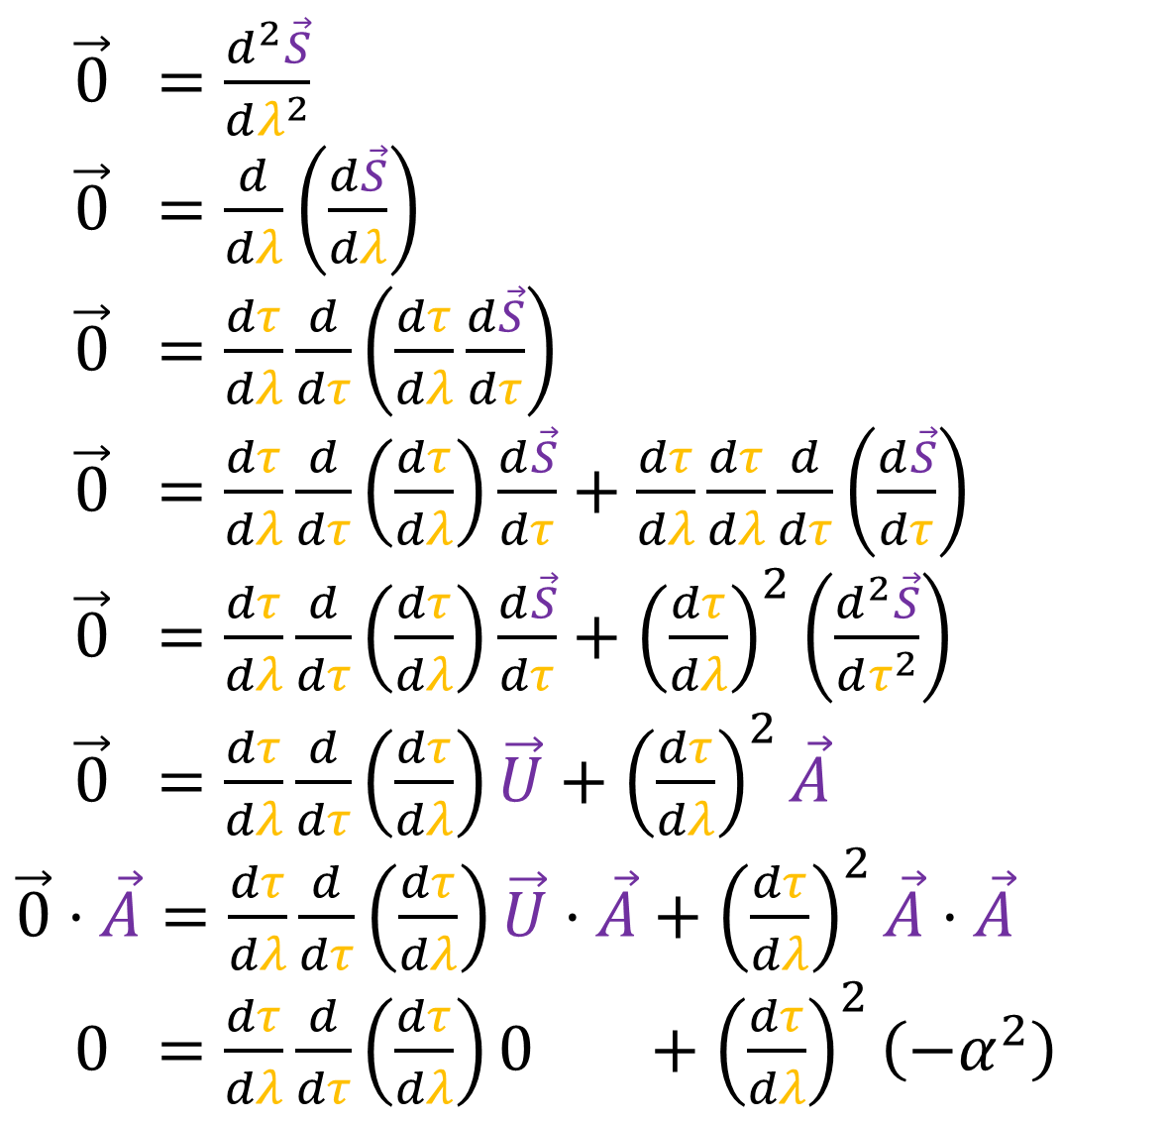
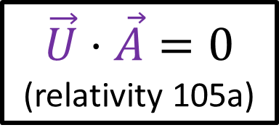
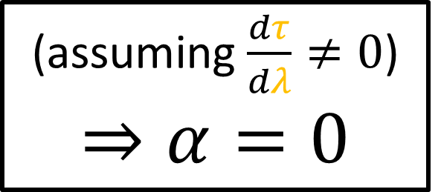
$\vec{0} =\frac{d^{2}\vec{S}}{dλ^{2}}$
$\vec{0} =\frac{d}{dλ}\left(\frac{d\vec{S}}{dλ}\right)$
$\vec{0} =\frac{dτ}{dλ}\frac{d}{dτ}\left(\frac{dτ}{dλ}\frac{d\vec{S}}{dτ}\right)$
$\vec{0} =\frac{dτ}{dλ}\frac{d}{dτ}\left(\frac{dτ}{dλ}\right)\frac{d\vec{S}}{dτ}+\frac{dτ}{dλ}\frac{dτ}{dλ}\frac{d}{dτ}\left(\frac{d\vec{S}}{dτ}\right)$
$\vec{0} =\frac{dτ}{dλ}\frac{d}{dτ}\left(\frac{dτ}{dλ}\right)\frac{d\vec{S}}{dτ}+{\left(\frac{dτ}{dλ}\right)}^{2}\left(\frac{d^{2}\vec{S}}{dτ^{2}}\right)$
$\vec{0} =\frac{dτ}{dλ}\frac{d}{dτ}\left(\frac{dτ}{dλ}\right)\vec{U}+{\left(\frac{dτ}{dλ}\right)}^{2}\vec{A}$
$\vec{0}⋅\vec{A}=\frac{dτ}{dλ}\frac{d}{dτ}\left(\frac{dτ}{dλ}\right)\vec{U}⋅\vec{A}+{\left(\frac{dτ}{dλ}\right)}^{2}\vec{A}⋅\vec{A}$
$0 =\frac{dτ}{dλ}\frac{d}{dτ}\left(\frac{dτ}{dλ}\right)0 +{\left(\frac{dτ}{dλ}\right)}^{2}\left(−α^{2}\right)$
Proof that equation describes inertial frames.
chain rule
product rule
$$\vec{U}⋅\vec{A}=0$$
(relativity 105a)
(assuming $\frac{dτ}{dλ}≠0$)
$$⇒α=0$$

Slide 19


$\vec{0} =\frac{d^{2}\vec{S}}{dλ^{2}}$
$\vec{0} =\frac{d}{dλ}\left(\frac{d\vec{S}}{dλ}\right)$
$\vec{0} =\frac{dτ}{dλ}\frac{d}{dτ}\left(\frac{dτ}{dλ}\frac{d\vec{S}}{dτ}\right)$
$\vec{0} =\frac{dτ}{dλ}\frac{d}{dτ}\left(\frac{dτ}{dλ}\right)\frac{d\vec{S}}{dτ}+\frac{dτ}{dλ}\frac{dτ}{dλ}\frac{d}{dτ}\left(\frac{d\vec{S}}{dτ}\right)$
$\vec{0} =\frac{dτ}{dλ}\frac{d}{dτ}\left(\frac{dτ}{dλ}\right)\frac{d\vec{S}}{dτ}+{\left(\frac{dτ}{dλ}\right)}^{2}\left(\frac{d^{2}\vec{S}}{dτ^{2}}\right)$
$\vec{0} =\frac{dτ}{dλ}\frac{d}{dτ}\left(\frac{dτ}{dλ}\right)\vec{U}+{\left(\frac{dτ}{dλ}\right)}^{2}\vec{A}$
$\vec{0}⋅\vec{A}=\frac{dτ}{dλ}\frac{d}{dτ}\left(\frac{dτ}{dλ}\right)\vec{U}⋅\vec{A}+{\left(\frac{dτ}{dλ}\right)}^{2}\vec{A}⋅\vec{A}$
$0 =\frac{dτ}{dλ}\frac{d}{dτ}\left(\frac{dτ}{dλ}\right)0 +{\left(\frac{dτ}{dλ}\right)}^{2}\left(−α^{2}\right)$
Proof that equation describes inertial frames.
chain rule
product rule
$$\vec{U}⋅\vec{A}=0$$
(relativity 105a)
(assuming $\frac{dτ}{dλ}≠0$)
$$⇒α=0$$

Slide 20
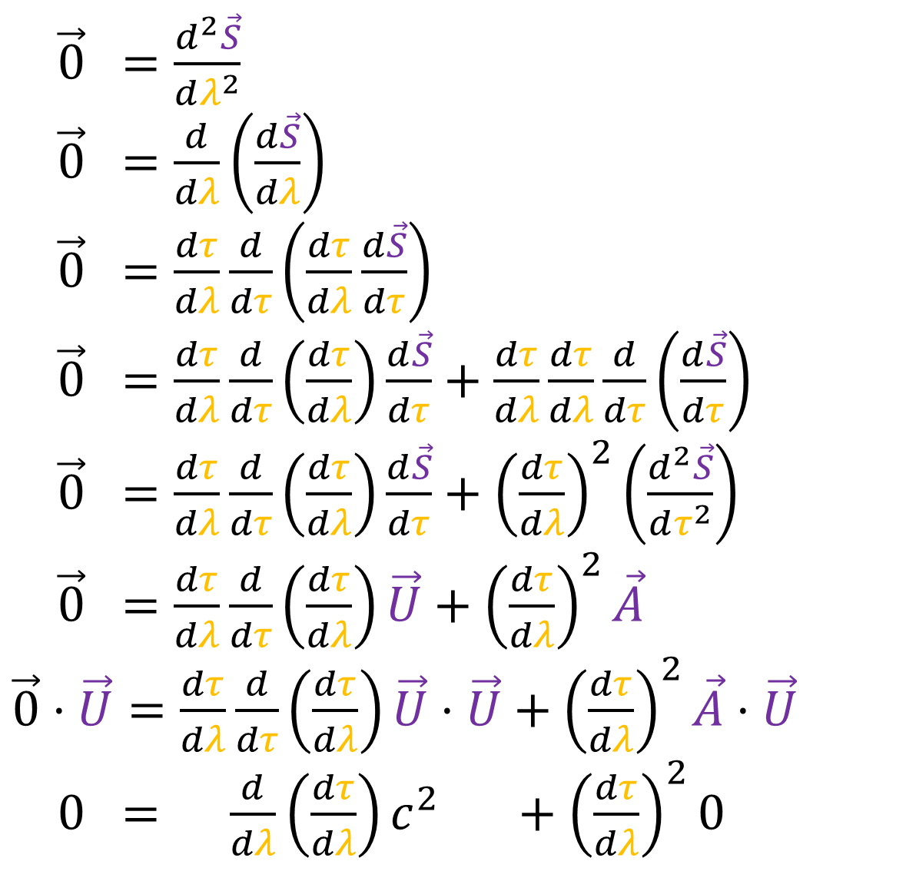
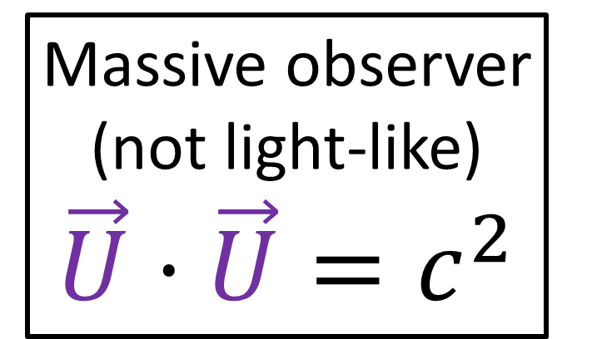
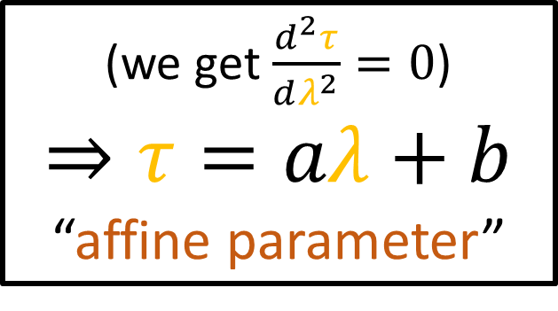
$\vec{0} =\frac{d^{2}\vec{S}}{dλ^{2}}$
$\vec{0} =\frac{d}{dλ}\left(\frac{d\vec{S}}{dλ}\right)$
$\vec{0} =\frac{dτ}{dλ}\frac{d}{dτ}\left(\frac{dτ}{dλ}\frac{d\vec{S}}{dτ}\right)$
$\vec{0} =\frac{dτ}{dλ}\frac{d}{dτ}\left(\frac{dτ}{dλ}\right)\frac{d\vec{S}}{dτ}+\frac{dτ}{dλ}\frac{dτ}{dλ}\frac{d}{dτ}\left(\frac{d\vec{S}}{dτ}\right)$
$\vec{0} =\frac{dτ}{dλ}\frac{d}{dτ}\left(\frac{dτ}{dλ}\right)\frac{d\vec{S}}{dτ}+{\left(\frac{dτ}{dλ}\right)}^{2}\left(\frac{d^{2}\vec{S}}{dτ^{2}}\right)$
$\vec{0} =\frac{dτ}{dλ}\frac{d}{dτ}\left(\frac{dτ}{dλ}\right)\vec{U}+{\left(\frac{dτ}{dλ}\right)}^{2}\vec{A}$
$\vec{0}⋅\vec{U}=\frac{dτ}{dλ}\frac{d}{dτ}\left(\frac{dτ}{dλ}\right)\vec{U}⋅\vec{U}+{\left(\frac{dτ}{dλ}\right)}^{2}\vec{A}⋅\vec{U}$
$0 = \frac{d}{dλ}\left(\frac{dτ}{dλ}\right)c^{2} +{\left(\frac{dτ}{dλ}\right)}^{2}0$
Proof that equation describes inertial frames.
Massive observer (not light-like)
$$\vec{U}⋅\vec{U}=c^{2}$$
$$\vec{U}⋅\vec{A}=0$$
(relativity 105a)
(we get $\frac{d^{2}τ}{dλ^{2}}=0$)
$$⇒τ=aλ+b$$
“affine parameter”

Slide 21
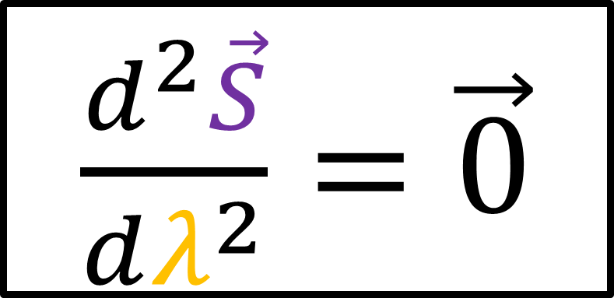

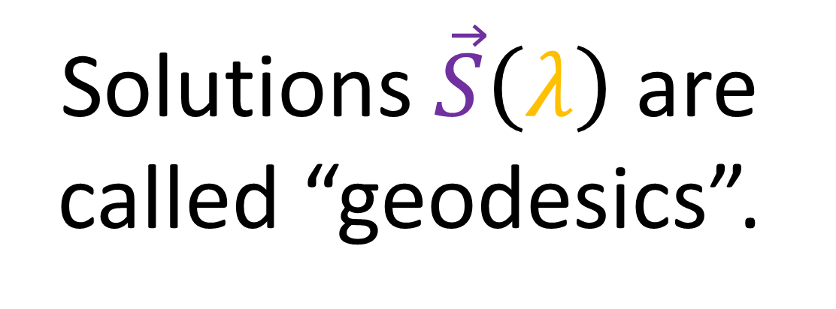
Geodesic Equation
Solutions $\vec{S}\left(λ\right)$ are called “geodesics”.
$\frac{d^{2}\vec{S}}{dλ^{2}}=\vec{0}$
Inertial
worldlines
Light-like
worldlines
$\vec{A}=\frac{d^{2}\vec{S}}{dτ^{2}}=\vec{0}$

Slide 22
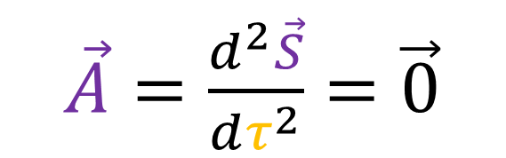
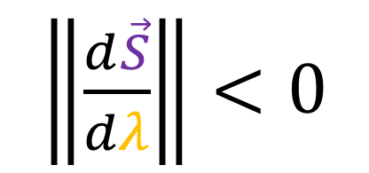
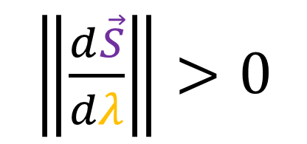

$\left\|\frac{d\vec{S}}{dλ}\right\|<0$
$\left\|\frac{d\vec{S}}{dλ}\right\|>0$
$\left\|\frac{d\vec{S}}{dλ}\right\|=0$
Time-like
(inertial)
geodesics
Light-like (null)
geodesics
Space-like geodesics
(not in this video)
$\vec{A}=\frac{d^{2}\vec{S}}{dτ^{2}}=\vec{0}$

Slide 23


How do we know which worldlines are inertial, and which worldlines are not?
Geodesic Equation
Inertial Worldlines:
$\frac{d^{2}\vec{S}}{dλ^{2}}=\vec{0}$

Slide 24

Geodesic Path in Spacetime:
Inertial observers will always see geodesics as being straight lines
Non-inertial observers will see geodesics as being curved
Geodesic Equation
$\frac{d^{2}\vec{S}}{dλ^{2}}=\vec{0}$

Slide 25
Geodesic Path in Spacetime:
Worldline that is straight from the perspective of an inertial observer
“straightest possible path between two points in spacetime”
Can appear curved to non-inertial observers
Any curve that satisfies this equation is a geodesic curve
Geodesic Equation
$\frac{d^{2}\vec{S}}{dλ^{2}}=\vec{0}$

Slide 26

In Rindler Coordinates…
“Inertial” observers have a hyperbolic secant worldline
In Rindler Coordinates, light beams have exponential worldlines
Use Geodesic Equation to solve for any geodesic curve in Rindler coordinates (Christoffel symbols)
$\frac{d^{2}\vec{S}}{dλ^{2}}=\vec{0}$

Slide 27







Inertial Coordinates
Geodesic Equation
$$\vec{S}=ct\vec{e_{t}}+x\vec{e_{x}}$$
$\frac{d^{2}\vec{S}}{dλ^{2}}=\vec{0}$
$\frac{d\vec{e_{t}}}{dλ}=\frac{d\vec{e_{x}}}{dλ}=\vec{0}$
$\frac{d^{2}\vec{S}}{dλ^{2}}=\frac{d^{2}\left(ct\right)}{dλ^{2}}\vec{e_{t}}+\frac{d^{2}x}{dλ^{2}}\vec{e_{x}}=\vec{0}$
$\frac{d^{2}\left(ct\right)}{dλ^{2}}=0$
$\frac{d^{2}x}{dλ^{2}}=0$

Slide 28









$\frac{d^{2}\left(ct\right)}{dλ^{2}}=0$
$$⇒$$
$$ct\left(λ\right)=d^{t} λ+ k^{t}$$
$\frac{d^{2}x}{dλ^{2}}=0$
$$⇒$$
$$x\left(λ\right)=d^{x} λ+ k^{x}$$
Initial direction
$\frac{d\vec{S}}{dλ}\left(λ=0\right)$
Initial position
$$\vec{S}\left(λ=0\right)$$

Slide 29










$$\vec{S}\left(λ\right)=ct\left(λ\right)\vec{e_{t}}+x\left(λ\right)\vec{e_{x}}$$
$$ct$$
$$ct\left(λ\right)=d^{t}λ+k^{t}$$
$$x\left(λ\right)=d^{x}λ+k^{x}$$
$$x$$
$$k^{t}=−1, k^{x}=2$$
$\frac{d\vec{S}}{dλ}\left(λ=0\right)$
$$d^{t}= 2, d^{x}=1$$
$$\vec{S}\left(λ=0\right)$$
$$\vec{S}\left(λ\right)= \left(−1\vec{e_{t}}+2\vec{e_{x}}\right)$$
$$+ λ\left( 2\vec{e_{t}}+1\vec{e_{x}}\right)$$

Slide 30






$$\vec{S}\left(λ\right)=ct\left(λ\right)\vec{e_{t}}+x\left(λ\right)\vec{e_{x}}$$
$$ct$$
$$ct\left(λ\right)=d^{t}λ+k^{t}$$
$$x\left(λ\right)=d^{x}λ+k^{x}$$
$\frac{d\vec{S}}{dλ}\left(λ=0\right)$
$$x$$
$$k^{t}=0, k^{x}=x_{0}$$
$$d^{t}=1, d^{x}=0$$
$$\vec{S}\left(λ=0\right)$$
$$\vec{S}\left(λ\right)=x_{0}\vec{e_{x}} +λ\vec{e_{t}}$$

Slide 31








Rindler Coordinates
$ct=\tilde{x}\sinh\left(\frac{c\tilde{t}}{D}\right)$
$x=\tilde{x}\cosh\left(\frac{c\tilde{t}}{D}\right)$
$$ct$$
$$c\tilde{t}=+∞$$
$$c\tilde{t}$$
$$\tilde{x}$$
Stationary observer has $x=x_{0}$.
$$x$$
$ct=λ$
$x=x_{0}$
$$c\tilde{t}=−∞$$

Slide 32




Rindler Coordinates
$ct=\tilde{x}\sinh\left(\frac{c\tilde{t}}{D}\right)$
$x=\tilde{x}\cosh\left(\frac{c\tilde{t}}{D}\right)$
$$ct$$
$$c\tilde{t}=+∞$$
$D=\frac{c^{2}}{α}$
$$c\tilde{t}$$
$$\tilde{x}$$
Stationary observer has $x=x_{0}$.
$$x$$
$x=\tilde{x}\cosh\left(\frac{c\tilde{t}}{D}\right)=x_{0}$
$⇒\tilde{x}=x_{0}\frac{1}{\cosh\left(\frac{c\tilde{t}}{D}\right)}$
$⇒\tilde{x}=x_{0}\operatorname{sech}\left(\frac{c\tilde{t}}{D}\right)$
$$x_{0}$$
$$c\tilde{t}=−∞$$

Slide 33




Rindler Coordinates
$ct=\tilde{x}\sinh\left(\frac{c\tilde{t}}{D}\right)$
$x=\tilde{x}\cosh\left(\frac{c\tilde{t}}{D}\right)$
$$ct$$
$$c\tilde{t}=+∞$$
$$c\tilde{t}$$
$$\tilde{x}$$
If we plug in $\tilde{x}=\frac{x_{0}}{\cosh\left(\frac{c\tilde{t}}{D}\right)}$ …
$$x$$
$ct=\frac{x_{0}}{\cosh\left(\frac{c\tilde{t}}{D}\right)}\sinh\left(\frac{c\tilde{t}}{D}\right)$
$=x_{0}\tanh\left(\frac{c\tilde{t}}{D}\right)$
$$∈\left(−x_{0},+x_{0}\right)$$
$$c\tilde{t}=−∞$$

Slide 34







$$\tanh\left(q\right)$$
$$∈\left(−1,+1\right)$$
$$+1$$
$$q$$
$$−1$$

Slide 35




Rindler Coordinates
$ct=\tilde{x}\sinh\left(\frac{c\tilde{t}}{D}\right)$
$x=\tilde{x}\cosh\left(\frac{c\tilde{t}}{D}\right)$
$$ct$$
$$c\tilde{t}=+∞$$
$$c\tilde{t}$$
$$\tilde{x}$$
$${ct =x}_{0}$$
If we plug in $\tilde{x}=\frac{x_{0}}{\cosh\left(\frac{c\tilde{t}}{D}\right)}$ …
$$x$$
$ct=\frac{x_{0}}{\cosh\left(\frac{c\tilde{t}}{D}\right)}\sinh\left(\frac{c\tilde{t}}{D}\right)$
$=x_{0}\tanh\left(\frac{c\tilde{t}}{D}\right)$
$${ct =−x}_{0}$$
$$∈\left(−x_{0},+x_{0}\right)$$
$$c\tilde{t}=−∞$$

Slide 36


Slide 37


Inertial Observer’s perspective
Non-Inertial Observer’s perspective
$$x=x_{0}$$
$\tilde{x}=x_{0}\operatorname{sech}\left(\frac{c\tilde{t}}{D}\right)$

Slide 38



“Vertical” Inertial Worldline
$$x=x_{0}$$
$\tilde{x}=x_{0}\operatorname{sech}\left(\frac{c\tilde{t}}{D}\right)$

Slide 39





General Inertial Worldline
$$x=βct+x_{0}$$
$\tilde{x}=x_{0}\cosh\left(φ\right)\operatorname{sech}\left(\frac{c\tilde{t}}{D}−φ\right)$
$$β≡\tanh\left(φ\right)$$

Slide 40




$\cosh\left(φ±θ\right)=\cosh\left(φ\right)\cosh\left(θ\right)±\sinh\left(φ\right)\sinh\left(θ\right)$
$$β≡\tanh\left(φ\right)$$
Inertial observer has $x=βct+x_{0}$ ...
$ct=\tilde{x}\sinh\left(\frac{c\tilde{t}}{D}\right)$
$x=\tilde{x}\cosh\left(\frac{c\tilde{t}}{D}\right)$
$⇒\tilde{x}\cosh\left(\frac{c\tilde{t}}{D}\right)=β\tilde{x}\sinh\left(\frac{c\tilde{t}}{D}\right)+x_{0}$
$⇒\tilde{x}\left[\cosh\left(\frac{c\tilde{t}}{D}\right)−β\sinh\left(\frac{c\tilde{t}}{D}\right)\right]=x_{0}$
$⇒\tilde{x}\frac{1}{\cosh\left(φ\right)}\left[\cosh\left(φ\right)\cosh\left(\frac{c\tilde{t}}{D}\right)−β\cosh\left(φ\right)\sinh\left(\frac{c\tilde{t}}{D}\right)\right]=x_{0}$
$⇒\tilde{x}\frac{1}{\cosh\left(φ\right)}\left[\cosh\left(φ\right)\cosh\left(\frac{c\tilde{t}}{D}\right)−\sinh\left(φ\right)\sinh\left(\frac{c\tilde{t}}{D}\right)\right]=x_{0}$
$⇒\tilde{x}\frac{1}{\cosh\left(φ\right)}\cosh\left(\frac{c\tilde{t}}{D}−φ\right)=x_{0}$
$⇒\tilde{x}=x_{0}\cosh\left(φ\right)$ $\frac{1}{\cosh\left(\frac{c\tilde{t}}{D}−φ\right)}$ $=x_{0}\cosh\left(φ\right)\operatorname{sech}\left(\frac{c\tilde{t}}{D}−φ\right)$

Slide 41

In Rindler Coordinates…
“Inertial” observers have a hyperbolic secant worldline
In Rindler Coordinates, light beams have exponential worldlines
Use Geodesic Equation to solve for any geodesic curve in Rindler coordinates (Christoffel symbols)
$\frac{d^{2}\vec{S}}{dλ^{2}}=\vec{0}$

Slide 42







$$\vec{S}\left(λ\right)=ct\left(λ\right)\vec{e_{t}}+x\left(λ\right)\vec{e_{x}}$$
$$ct$$
$$ct\left(λ\right)=d^{t}λ+k^{t}$$
$\frac{d\vec{S}}{dλ}\left(λ=0\right)$
$$x\left(λ\right)=d^{x}λ+k^{x}$$
$$x$$
$$k^{t}=0 k^{x}=x_{0}$$
$$\vec{S}\left(λ=0\right)$$
$$d^{t}=1, d^{x}=1$$
$$\vec{S}\left(λ\right)=x_{0} \vec{e_{x}}$$
$+λ\left(\vec{e_{t}}+\vec{e_{x}}\right)$

Slide 43






Rindler Coordinates
$ct=\tilde{x}\sinh\left(\frac{c\tilde{t}}{D}\right)$
$x=\tilde{x}\cosh\left(\frac{c\tilde{t}}{D}\right)$
$$ct$$
$$c\tilde{t}=+∞$$
$$c\tilde{t}$$
$$\tilde{x}$$
Light beam has $x=ct+x_{0}$.
$$x$$
$\tilde{x}\cosh\left(\frac{c\tilde{t}}{D}\right)=\tilde{x}\sinh\left(\frac{c\tilde{t}}{D}\right)+x_{0}$
$\tilde{x}\frac{1}{2}\left(e^{\frac{c\tilde{t}}{D}}+e^{− \frac{c\tilde{t}}{D}}\right)=\tilde{x}\frac{1}{2}\left(e^{\frac{c\tilde{t}}{D}}−e^{− \frac{c\tilde{t}}{D}}\right)+x_{0}$
$\tilde{x}e^{− \frac{c\tilde{t}}{D}}=x_{0}$
$\tilde{x}=x_{0}e^{\frac{c\tilde{t}}{D}}$
$$x_{0}$$
$$c\tilde{t}=−∞$$

Slide 44



“Diagonal” Light Worldline
$$x=ct+x_{0}$$
$$\tilde{x}=x_{0}e^{\frac{c\tilde{t}}{D}}$$

Slide 45




“Diagonal” Light Worldline
$$x=−ct+x_{0}$$
$$\tilde{x}=x_{0}e^{−\frac{c\tilde{t}}{D}}$$

Slide 46



“Diagonal” Light Worldline
$$x=±ct+x_{0}$$
$$\tilde{x}=x_{0}e^{±\frac{c\tilde{t}}{D}}$$

Slide 47

In Rindler Coordinates…
“Inertial” observers have a hyperbolic secant worldline
In Rindler Coordinates, light beams have exponential worldlines
Use Geodesic Equation to solve for any geodesic curve in Rindler coordinates (Christoffel symbols)
$\frac{d^{2}\vec{S}}{dλ^{2}}=\vec{0}$

Slide 48



Change to Rindler coordinates
$ct=\tilde{x}\sinh\left(\frac{c\tilde{t}}{D}\right)$
$x=\tilde{x}\cosh\left(\frac{c\tilde{t}}{D}\right)$
$$x=x_{0}$$
$\tilde{x}=x_{0}\operatorname{sech}\left(\frac{c\tilde{t}}{D}\right)$
Possible to figure out what geodesics look like in Rindler coordinates without referencing inertial coordinates at all.

Slide 49



$\vec{0}$ $=\frac{d^{2}}{dλ^{2}}\vec{S}=\frac{d^{2}}{dλ^{2}}\left(\tilde{x}\tilde{\vec{e_{x}}}\right)$
Geodesic Equation
$0\tilde{\vec{e_{t}}}+0\tilde{\vec{e_{x}}}=\left(\frac{d^{2}c\tilde{t}}{dλ^{2}}+2\frac{1}{\tilde{x}}\frac{d c\tilde{t}}{dλ}\frac{d\tilde{x}}{dλ}\right)\tilde{\vec{e_{t}}}+\left(\frac{d^{2}\tilde{x}}{dλ^{2}}+\frac{1}{D^{2}}\tilde{x}{\left(\frac{d c\tilde{t}}{dλ}\right)}^{2}\right)\tilde{\vec{e_{x}}}$
(We learned the covariant derivative in Rindler coordinates in Relativity 105e)
$0=\frac{d^{2}c\tilde{t}}{dλ^{2}}+2\frac{1}{\tilde{x}}\frac{d c\tilde{t}}{dλ}\frac{d\tilde{x}}{dλ}$ $0= \frac{d^{2}\tilde{x}}{dλ^{2}}+\frac{1}{D^{2}}\tilde{x}{\left(\frac{d c\tilde{t}}{dλ}\right)}^{2}$
Geodesic Equations
(Component Form) (Rindler Coordinates)

Slide 50




Solutions are not obvious!!!
$\frac{d c\tilde{t}}{dλ}\frac{d\tilde{x}}{dλ}$
Derivative products $→$ NON-LINEAR!
Mixing $c\tilde{t}$ and $\tilde{x}$ $→$ COUPLED!
The final result is the important part… don’t worry about steps too much at this stage.
$0=\frac{d^{2}c\tilde{t}}{dλ^{2}}+2\frac{1}{\tilde{x}}\frac{d c\tilde{t}}{dλ}\frac{d\tilde{x}}{dλ}$ $0= \frac{d^{2}\tilde{x}}{dλ^{2}}+\frac{1}{D^{2}}\tilde{x}{\left(\frac{d c\tilde{t}}{dλ}\right)}^{2}$
Geodesic Equations
(Component Form) (Rindler Coordinates)

Slide 51





$0=\frac{d^{2}c\tilde{t}}{dλ^{2}}+2\frac{1}{\tilde{x}}\frac{d c\tilde{t}}{dλ}\frac{d\tilde{x}}{dλ}$ $0= \frac{d^{2}\tilde{x}}{dλ^{2}}+\frac{1}{D^{2}}\tilde{x}{\left(\frac{d c\tilde{t}}{dλ}\right)}^{2}$
Non-linear, coupled differential equations…. (hard to solve!)
$K = {\tilde{x}}^{2}\frac{d c\tilde{t}}{dλ}$
$\frac{d}{dλ}\left(K\right)=\frac{d}{dλ}\left({\tilde{x}}^{2}\frac{d c\tilde{t}}{dλ}\right)$
$0=\frac{d}{dλ}\left({\tilde{x}}^{2}\right)\frac{d c\tilde{t}}{dλ}+{\tilde{x}}^{2}\frac{d}{dλ}\left(\frac{d c\tilde{t}}{dλ}\right)$
$0=2\tilde{x}\frac{d\tilde{x}}{dλ}\frac{d c\tilde{t}}{dλ}+{\tilde{x}}^{2}\frac{d^{2}c\tilde{t}}{dλ^{2}}$
Constant of Motion
$K={\tilde{x}}^{2}\frac{d c\tilde{t}}{dλ}$
$⇒0=2\frac{1}{\tilde{x}}\frac{d\tilde{x}}{dλ}\frac{d c\tilde{t}}{dλ}+\frac{d^{2}c\tilde{t}}{dλ^{2}}$

Slide 52





https://math.stackexchange.com/questions/2970455/how-to-calculate-the-geodesics-in-polar-coordinates
Trick: set $\tilde{x}≡\frac{1}{\tilde{w}}$
$⇒$ $\frac{d\tilde{x}}{d\tilde{w}}=−\frac{1}{{\tilde{w}}^{2}}$
Constant of Motion
$K={\tilde{x}}^{2}\frac{d c\tilde{t}}{dλ}$
$K\frac{1}{{\tilde{x}}^{2}}=\frac{d c\tilde{t}}{dλ}$
$\frac{d\tilde{x}}{dλ}=\frac{d\tilde{x}}{d c\tilde{t}}\frac{d c\tilde{t}}{dλ}$

Slide 53





Partial Derivative:
Total Derivative:
$\frac{∂\tilde{x}}{∂ c\tilde{t}}$
$\frac{d\tilde{x}}{d c\tilde{t}}$
(how $\tilde{x}$ changes along
$c\tilde{t}$ coordinate curve)
(how $\tilde{x}$ changes with respect to $c\tilde{t}$along our geodesic curve)

Slide 54


https://math.stackexchange.com/questions/2970455/how-to-calculate-the-geodesics-in-polar-coordinates
Trick: set $\tilde{x}≡\frac{1}{\tilde{w}}$
$⇒$ $\frac{d\tilde{x}}{d\tilde{w}}=−\frac{1}{{\tilde{w}}^{2}}$
Constant of Motion
$K={\tilde{x}}^{2}\frac{d c\tilde{t}}{dλ}$
$K\frac{1}{{\tilde{x}}^{2}}=\frac{d c\tilde{t}}{dλ}$
$\frac{d\tilde{x}}{dλ}=\frac{d\tilde{x}}{d c\tilde{t}}\frac{d c\tilde{t}}{dλ}$
$\frac{d\tilde{x}}{dλ}=\frac{d\tilde{x}}{d\tilde{w}}\frac{d\tilde{w}}{d c\tilde{t}}\frac{d c\tilde{t}}{dλ}$
$\frac{d\tilde{x}}{dλ}=\frac{d\tilde{x}}{d\tilde{w}}\frac{d\tilde{w}}{d c\tilde{t}}K\frac{1}{{\tilde{x}}^{2}}$
$\frac{d\tilde{x}}{dλ}=\left(−\frac{1}{{\tilde{w}}^{2}}\right)\frac{d\tilde{w}}{d c\tilde{t}}K{\tilde{w}}^{2}$
$\frac{d\tilde{x}}{dλ}=−\frac{d\tilde{w}}{d c\tilde{t}}K$

Slide 55



https://math.stackexchange.com/questions/2970455/how-to-calculate-the-geodesics-in-polar-coordinates
Trick: set $\tilde{x}≡\frac{1}{\tilde{w}}$
$⇒$ $\frac{d\tilde{x}}{d\tilde{w}}=−\frac{1}{{\tilde{w}}^{2}}$
Constant of Motion
$K={\tilde{x}}^{2}\frac{d c\tilde{t}}{dλ}$
$K\frac{1}{{\tilde{x}}^{2}}=\frac{d c\tilde{t}}{dλ}$
$\frac{d^{2}\tilde{x}}{dλ^{2}}=\frac{d}{dλ}\left(\frac{d\tilde{x}}{dλ}\right)$
$\frac{d^{2}\tilde{x}}{dλ^{2}}=\frac{d c\tilde{t}}{dλ}\frac{d}{d c\tilde{t}}\left(\frac{d\tilde{x}}{dλ}\right)$
$\frac{d^{2}\tilde{x}}{dλ^{2}}=\left(K\frac{1}{{\tilde{x}}^{2}}\right)\frac{d}{d c\tilde{t}}\left(−\frac{d\tilde{w}}{d c\tilde{t}}K\right)$
$\frac{d^{2}\tilde{x}}{dλ^{2}}=−K^{2}{\tilde{w}}^{2}\frac{d^{2}\tilde{w}}{d {\left(c\tilde{t}\right)}^{2}}$
$\frac{d\tilde{x}}{dλ}=−\frac{d\tilde{w}}{d c\tilde{t}}K$

Slide 56






$0=\frac{d^{2}c\tilde{t}}{dλ^{2}}+2\frac{1}{\tilde{x}}\frac{d c\tilde{t}}{dλ}\frac{d\tilde{x}}{dλ}$ $0= \frac{d^{2}\tilde{x}}{dλ^{2}}+\frac{1}{D^{2}}\tilde{x}{\left(\frac{d c\tilde{t}}{dλ}\right)}^{2}$
Trick: set $\tilde{x}≡\frac{1}{\tilde{w}}$
$−\frac{d^{2}\tilde{x}}{dλ^{2}}=\frac{1}{D^{2}}\tilde{x}{\left(\frac{d c\tilde{t}}{dλ}\right)}^{2}$
$−\left(−K^{2}{\tilde{w}}^{2}\frac{d^{2}\tilde{w}}{d {\left(c\tilde{t}\right)}^{2}}\right)=\frac{1}{D^{2}}\tilde{x}{\left(K\frac{1}{{\tilde{x}}^{2}}\right)}^{2}$
$K^{2}{\tilde{w}}^{2}\frac{d^{2}\tilde{w}}{d {\left(c\tilde{t}\right)}^{2}} =\frac{1}{D^{2}}K^{2}{\tilde{w}}^{3}$
$\frac{d^{2}\tilde{w}}{d {\left(c\tilde{t}\right)}^{2}} =\frac{1}{D^{2}}\tilde{w}$
Constant of Motion
$K\frac{1}{{\tilde{x}}^{2}}=\frac{d c\tilde{t}}{dλ}$
$\frac{d^{2}\tilde{x}}{dλ^{2}}=−K^{2}{\tilde{w}}^{2}\frac{d^{2}\tilde{w}}{d {\left(c\tilde{t}\right)}^{2}}$

Slide 57




$0=\frac{d^{2}c\tilde{t}}{dλ^{2}}+2\frac{1}{\tilde{x}}\frac{d c\tilde{t}}{dλ}\frac{d\tilde{x}}{dλ}$ $0= \frac{d^{2}\tilde{x}}{dλ^{2}}+\frac{1}{D^{2}}\tilde{x}{\left(\frac{d c\tilde{t}}{dλ}\right)}^{2}$
Trick: set $\tilde{x}≡\frac{1}{\tilde{w}}$
$\frac{d^{2}\tilde{w}}{d {\left(c\tilde{t}\right)}^{2}} =\frac{1}{D^{2}}\tilde{w}$
Solutions
$\frac{d^{2}\cosh\left(q\right)}{dq^{2}}=\cosh\left(q\right)$
$\frac{d^{2}\sinh\left(q\right)}{dq^{2}}=\sinh\left(q\right)$
(because…)
$\frac{d\cosh\left(q\right)}{dq}=\sinh\left(q\right)$
$\frac{d\sinh\left(q\right)}{dq}=\cosh\left(q\right)$
$⇒\tilde{w}=C_{1}\cosh\left(\frac{c\tilde{t}}{D}\right)+C_{2}\sinh\left(\frac{c\tilde{t}}{D}\right)$
$⇒\frac{1}{\tilde{x}}=C_{1}\cosh\left(\frac{c\tilde{t}}{D}\right)+C_{2}\sinh\left(\frac{c\tilde{t}}{D}\right)$
$⇒\tilde{x}\left(c\tilde{t}\right)=\frac{1}{C_{1}\cosh\left(\frac{c\tilde{t}}{D}\right)+C_{2}\sinh\left(\frac{c\tilde{t}}{D}\right)}$

Slide 58








General Solution For Geodesics in Rindler Coordinates:
$\tilde{x}\left(c\tilde{t}\right)=\frac{1}{C_{1}\cosh\left(\frac{c\tilde{t}}{D}\right)+C_{2}\sinh\left(\frac{c\tilde{t}}{D}\right)}$
$C_{1}=\frac{1}{x_{0}}, C_{2}=0$
$\tilde{x}\left(c\tilde{t}\right)=\frac{1}{\frac{1}{x_{0}}\cosh\left(\frac{c\tilde{t}}{D}\right)}=x_{0}\operatorname{sech}\left(\frac{c\tilde{t}}{D}\right)$
$$⇒$$
(time-like geodesic/inertial frame)
$C_{1}=\frac{1}{x_{0}}, C_{2}=±\frac{1}{x_{0}}$
$\tilde{x}\left(c\tilde{t}\right)=\frac{1}{\frac{1}{x_{0}}\cosh\left(\frac{c\tilde{t}}{D}\right)±\frac{1}{x_{0}}\sinh\left(\frac{c\tilde{t}}{D}\right)}$
$\tilde{x}\left(c\tilde{t}\right)=\frac{x_{0}}{\frac{1}{2}\left(e^{c\tilde{t}/D}+e^{−c\tilde{t}/D}\right)±\frac{1}{2}\left(e^{c\tilde{t}/D}−e^{−c\tilde{t}/D}\right)}$
$\tilde{x}\left(c\tilde{t}\right)=\frac{x_{0}}{e^{±c\tilde{t}/D}} = x_{0}e^{∓c\tilde{t}/D}$
$$⇒$$
(light-like/null geodesic)

Slide 59




General Solution For Geodesics in Rindler Coordinates:
$\tilde{x}\left(c\tilde{t}\right)=\frac{1}{C_{1}\cosh\left(\frac{c\tilde{t}}{D}\right)+C_{2}\sinh\left(\frac{c\tilde{t}}{D}\right)}$
Inertial Observer’s perspective
Non-Inertial Observer’s perspective
$C_{1}$ and $C_{2}$ together determine the initial position $\vec{S}$ and initial direction $\frac{d\vec{S}}{dλ}$ 4-vectors of the geodesic in spacetime.
geodesic
geodesic
geodesic
geodesic
Geodesic Equation
geodesic
$\frac{d^{2}\vec{S}}{dλ^{2}}=\vec{0}$
geodesic

Slide 60
General Solution For Geodesics in Rindler Coordinates:
$\tilde{x}\left(c\tilde{t}\right)=\frac{1}{C_{1}\cosh\left(\frac{c\tilde{t}}{D}\right)+C_{2}\sinh\left(\frac{c\tilde{t}}{D}\right)}$
Inertial Observer’s perspective
Non-Inertial Observer’s perspective

Slide 61



Summary
Geodesic Equation
$\frac{d^{2}\vec{S}}{dλ^{2}}=\vec{0}$
A geodesic is a worldline in spacetime that is straight in inertial frames.
For time-like worldlines, this gives worldlines of inertial frames and is equivalent to zero 4-acceleration $\frac{d^{2}\vec{S}}{dτ^{2}}=\vec{A}=\vec{0}$
But it also applies for light-like/null worldlines where proper time $τ=0$

Slide 62




Summary
Geodesic Equation
$\frac{d^{2}\vec{S}}{dλ^{2}}=\vec{0}$
A geodesic is a worldline in spacetime that is straight in inertial frames.
In inertial frames, geodesics appear as straight lines
In non-inertial frames, geodesics can be curved
$$x=x_{0}$$
$$x=ct+x_{0}$$
$\tilde{x}=x_{0}\operatorname{sech}\left(\frac{c\tilde{t}}{D}\right)$
$$\tilde{x}=x_{0}e^{c\tilde{t}/D}$$

Slide 63






Summary – Geodesics in Inertial Coords.
$\vec{0}=\frac{d^{2}\vec{S}}{dλ^{2}}=\left(\frac{d^{2}ct}{dλ^{2}}\right)\vec{e_{t}}+\left(\frac{d^{2}x}{dλ^{2}}\right)\vec{e_{x}}$
$$0=\frac{d^{2}ct}{dλ^{2}}$$
$$0=\frac{d^{2}x}{dλ^{2}}$$
$$⇒$$
$$ct\left(λ\right)=d^{t} λ+ k^{t}$$
$$⇒$$
$$x\left(λ\right)=d^{x} λ+ k^{x}$$

Slide 64







Summary – Geodesics in Rindler Coords.
$\vec{0}=\frac{d^{2}\vec{S}}{dλ^{2}}=\left(\frac{d^{2}c\tilde{t}}{dλ^{2}}+2\frac{1}{\tilde{x}}\frac{d c\tilde{t}}{dλ}\frac{d\tilde{x}}{dλ}\right)\tilde{\vec{e_{t}}}+\left(\frac{d^{2}\tilde{x}}{dλ^{2}}+\frac{1}{D^{2}}\tilde{x}{\left(\frac{d c\tilde{t}}{dλ}\right)}^{2}\right)\tilde{\vec{e_{x}}}$
$$\tilde{Γ_{tx}^{t}}=\tilde{Γ_{xt}^{t}}$$
$$\tilde{Γ_{tt}^{x}}$$
$0=\frac{d^{2}c\tilde{t}}{dλ^{2}}+2\frac{1}{\tilde{x}}\frac{d c\tilde{t}}{dλ}\frac{d\tilde{x}}{dλ}$
$0=\frac{d^{2}\tilde{x}}{dλ^{2}}+\frac{1}{D^{2}}\tilde{x}{\left(\frac{d c\tilde{t}}{dλ}\right)}^{2}$
$=\frac{d^{2}c\tilde{t}}{dλ^{2}}+Γ_{tx}^{t}\frac{d c\tilde{t}}{dλ}\frac{d\tilde{x}}{dλ}+Γ_{xt}^{t}\frac{d\tilde{x}}{dλ}\frac{d c\tilde{t}}{dλ}$
$=\frac{d^{2}\tilde{x}}{dλ^{2}}+Γ_{tt}^{x}\frac{d c\tilde{t}}{dλ}$ $\frac{d c\tilde{t}}{dλ}$
$0=\frac{d^{2}x^{σ}}{dλ^{2}}+Γ_{μν}^{σ}\frac{dx^{μ}}{dλ}\frac{dx^{ν}}{dλ}$
General geodesic eqn. (later video):

Slide 65
Last planned video for Special Relativity
… next we’ll do General Relativity!
In general relativity… spacetime is curved!
No such thing as a straight worldline
Geodesics still give us:
Worldline of freely falling observers in a gravitational field
Worldline of beams of light that take curved paths
Geodesic Equation
$\frac{d^{2}\vec{S}}{dλ^{2}}=\vec{0}$

